Slide 1
Azure Networking
Lecturer: Ngo Huy Bien
Software Engineering Department
Faculty of Information Technology
VNUHCM - University of Science
Ho Chi Minh City, Vietnam
nhbien@fit.hcmus.edu.vn

Slide 2

Objectives

Slide 3

Contents

Slide 4

References

Slide 5
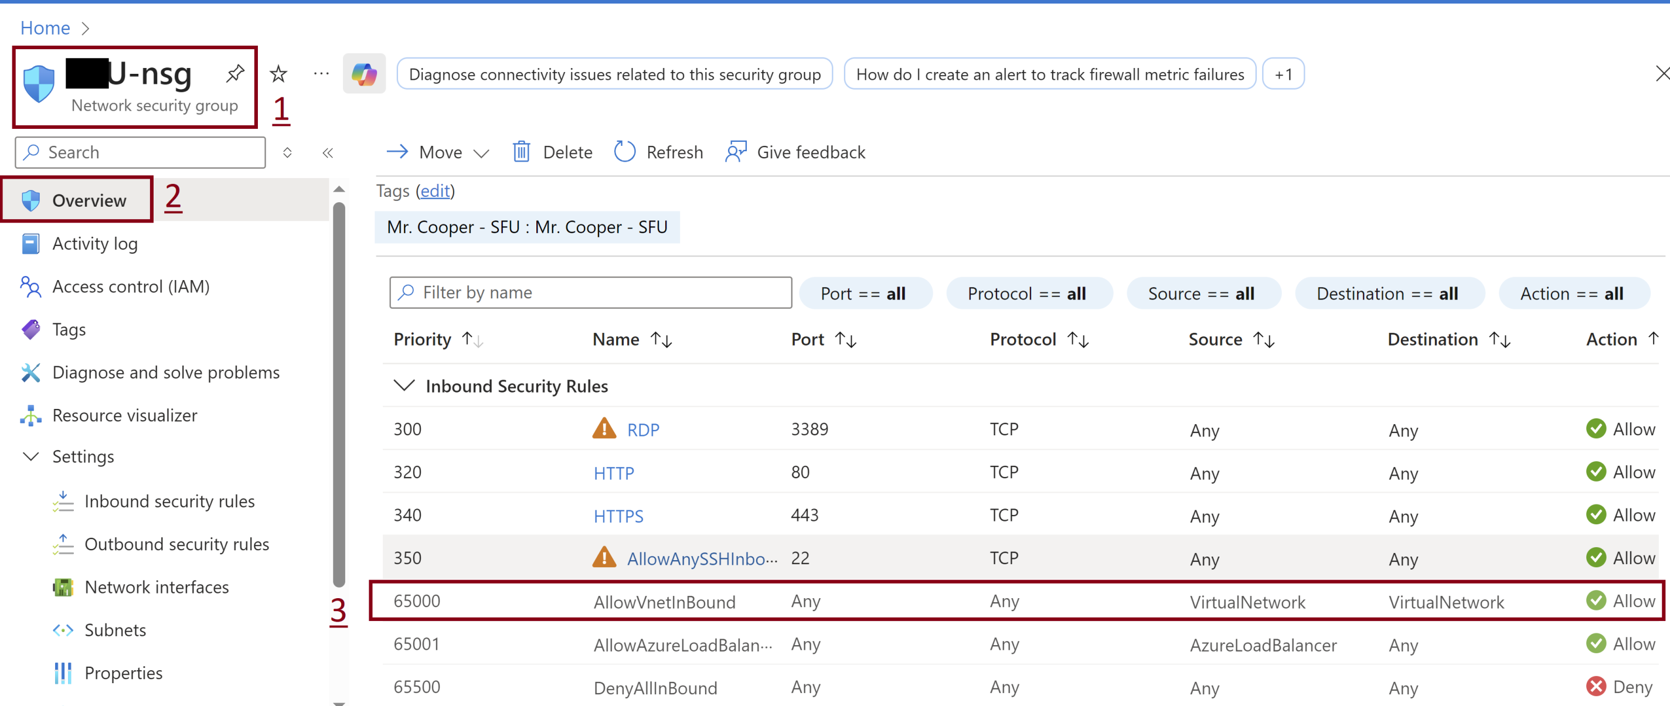
1. Review Service Security Group

Slide 6
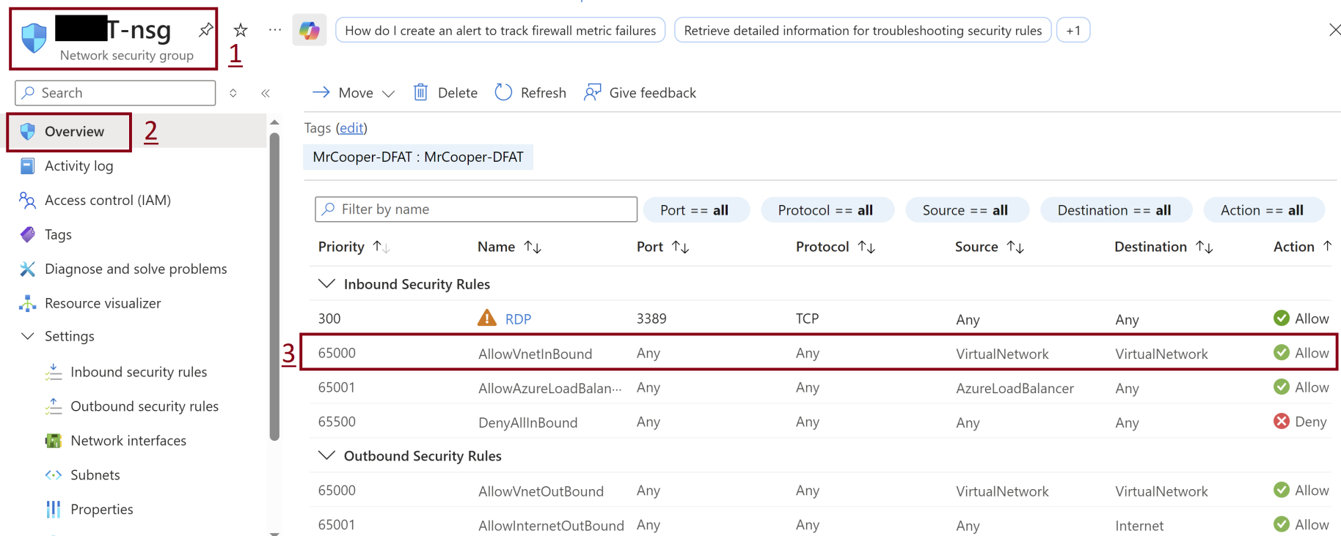
2. Review Client Security Group

Slide 7
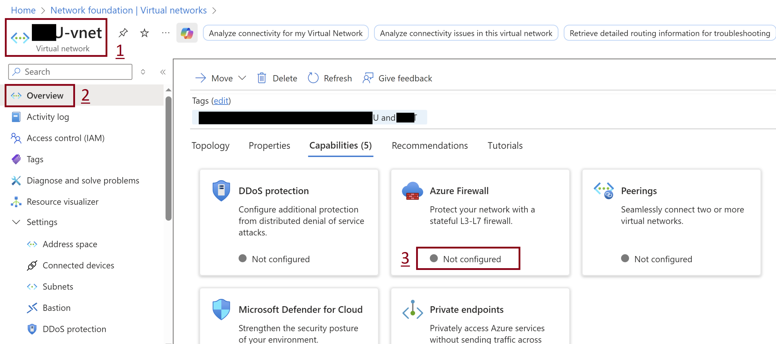
3. Review Virtual Network

Slide 8

Thank You & See You Again

